Slide 1
Data Enabled Prediction of Elastic Constants of Multi-Component Alloys
Final Presentation for ME 793 - 2022
Team ID : 10
Avish Wagde 180100023 Bimlesh Kumar Shah 213102007 Shridhar N 190100113

Slide 2
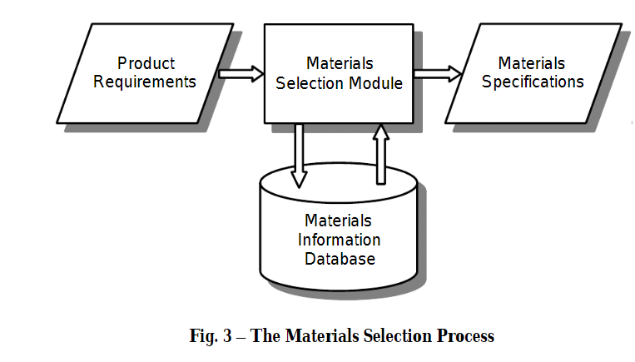
Motivation
ML route offers a much more efficient path towards targeted materials design, discovery and optimization
Reduces the time and resources required
Allows one to survey complex multiscale data and extract meaningful information
Objective
To determine elastic constants and other derived mechanical properties of multi-component alloys
To systematically select effective features for prediction
To analyze property trends to further understand the achieved performance
To use various ML models for better accuracy

Slide 3
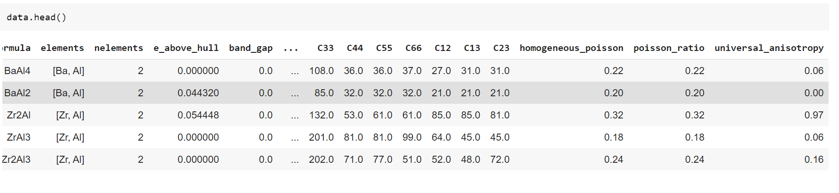
Binary Alloys
Data Collection Process
Tools used : MPRester API, Pymatgen, Pandas
Data : Binary Alloy data of 44 metals from Materials Project Database

Slide 4
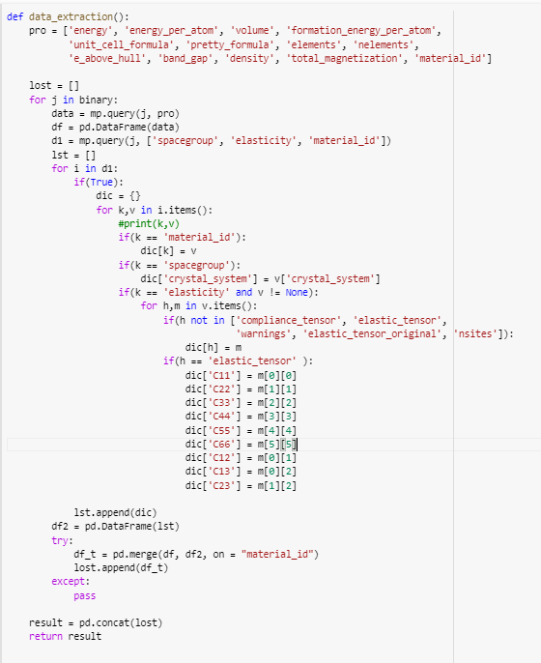
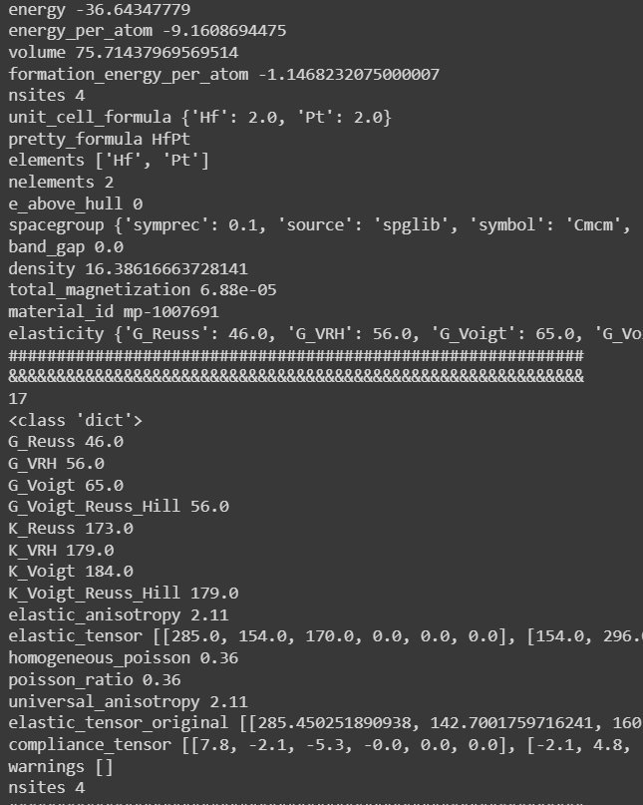
Data Collection and Curation Step

Slide 5
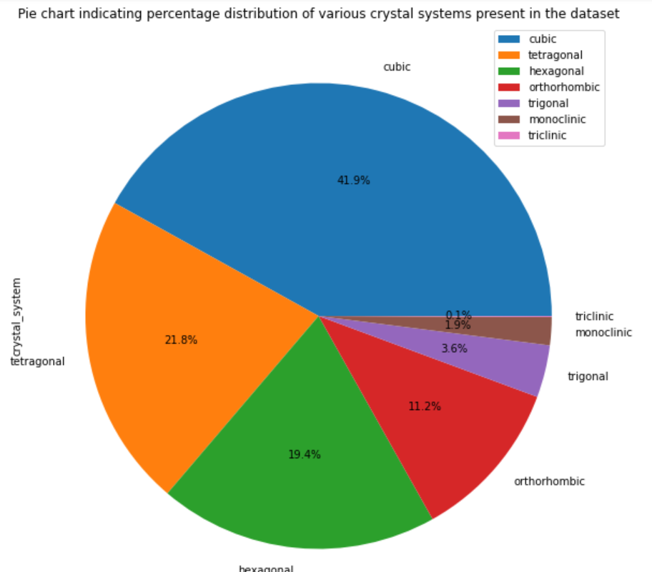
Data Preprocessing & Training the Model
No. of Data Points used :-
Initially - 4640 data points Finally - 1488 data points (after curation)
85% - 15% Train - Test split was performed on the data
A Random Forest Regression Model was trained on the data, since they provide a balance between the model interpretability and predictive accuracy

Slide 6
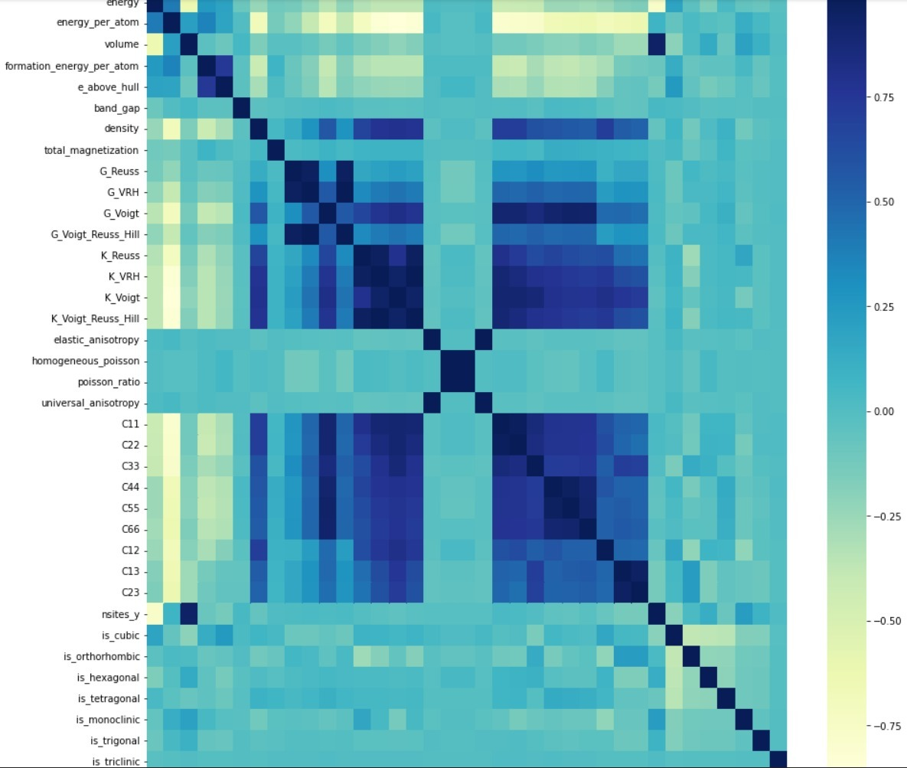
Correlation Analysis
Features = ['energy', 'energy_per_atom', 'volume', 'formation_energy_per_atom', 'density', 'G_Reuss', 'G_VRH', 'G_Voigt', 'G_Voigt_Reuss_Hill', 'K_Reuss', 'K_VRH', 'K_Voigt', 'K_Voigt_Reuss_Hill', 'elastic_anisotropy', 'is_cubic', 'is_orthorhombic', 'is_hexagonal', 'is_tetragonal', 'is_monoclinic', 'is_trigonal', 'is_triclinic']
Total 21 features
Prediction = ['C11', 'C22', 'C33', 'C44', 'C55', 'C66', 'C12', 'C13', 'C23']
Total 9
Pearson’s correlation plot for the features

Slide 7
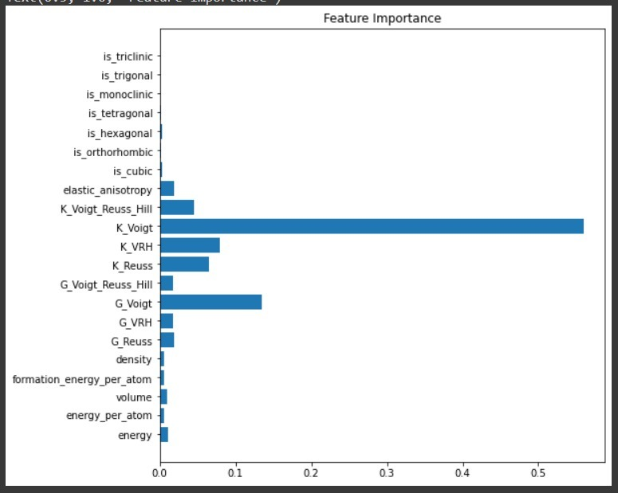
Test Results & Conclusions
The Feature importance plots indicates that K_Voigt(bulk modulus), G_Voigt(shear modulus) are the features dominating the predictions
Many of the features like crystal systems, formation energies and densities contribute very less

Slide 8
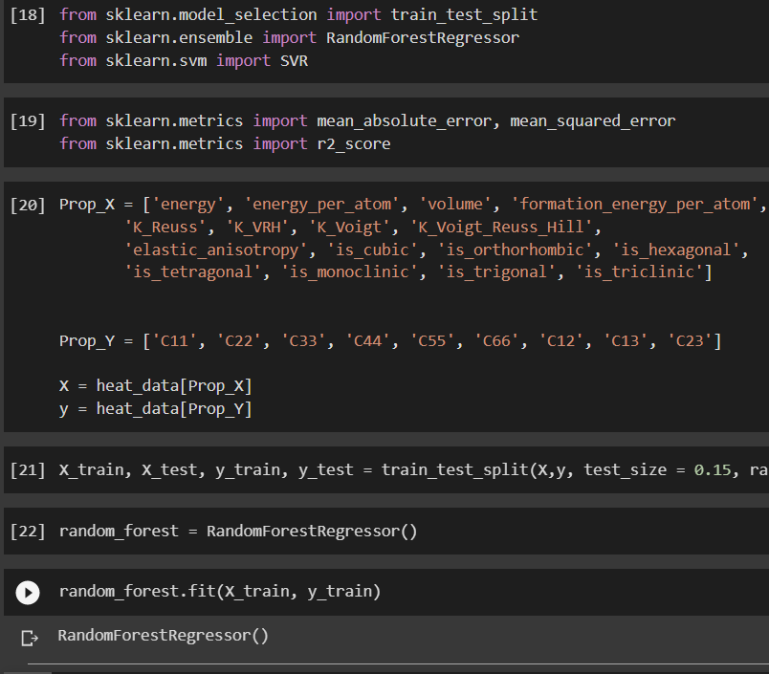
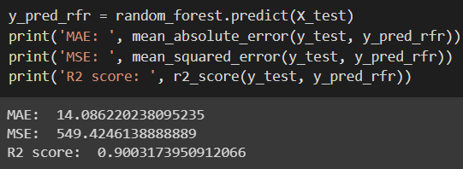
Code snippets

Slide 9
Test Results & Conclusions
MAE: 14.102
MSE: 546.138
R2 score: 0.900
Low MAE and High R2 values indicates that good accuracy of the model
MSE values are higher due to the presence of outliers or large variance in the data.

Slide 10
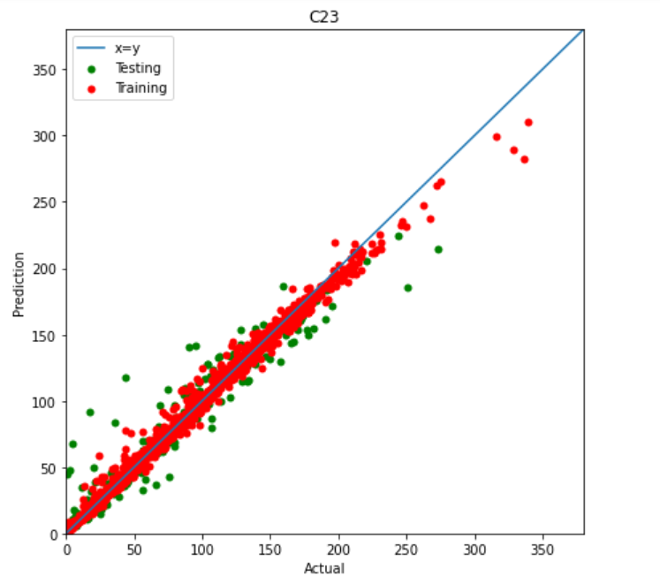
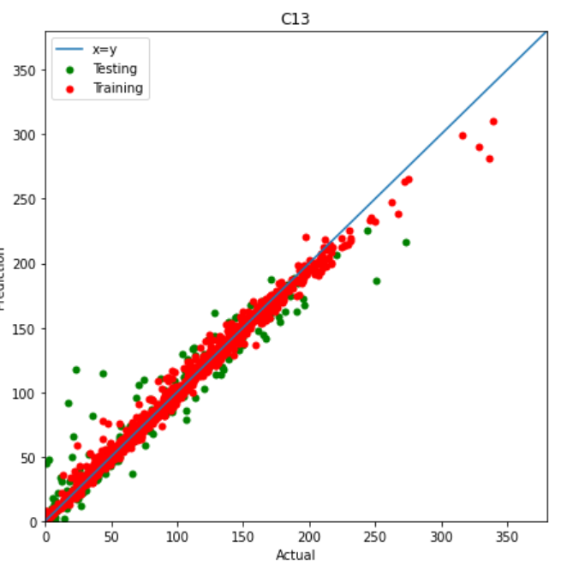
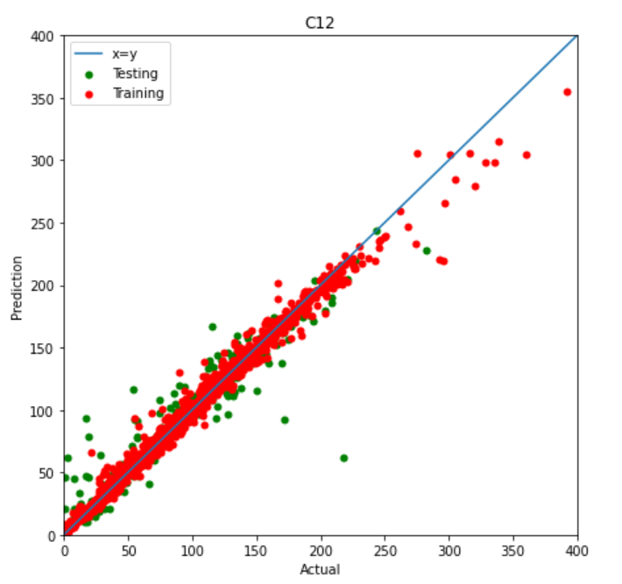
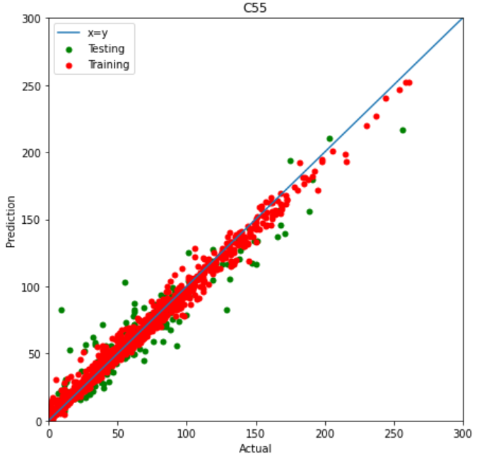

Test Results & Conclusions

Slide 11

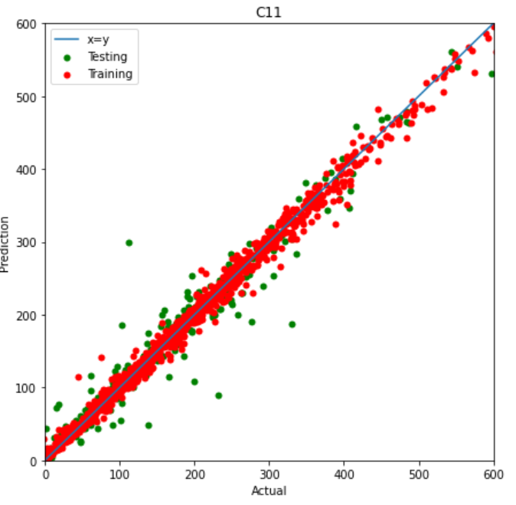
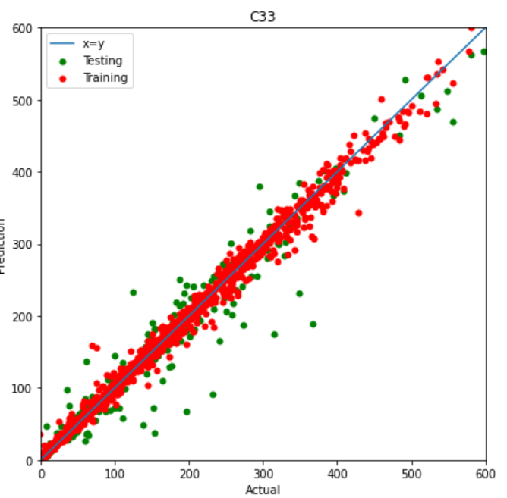
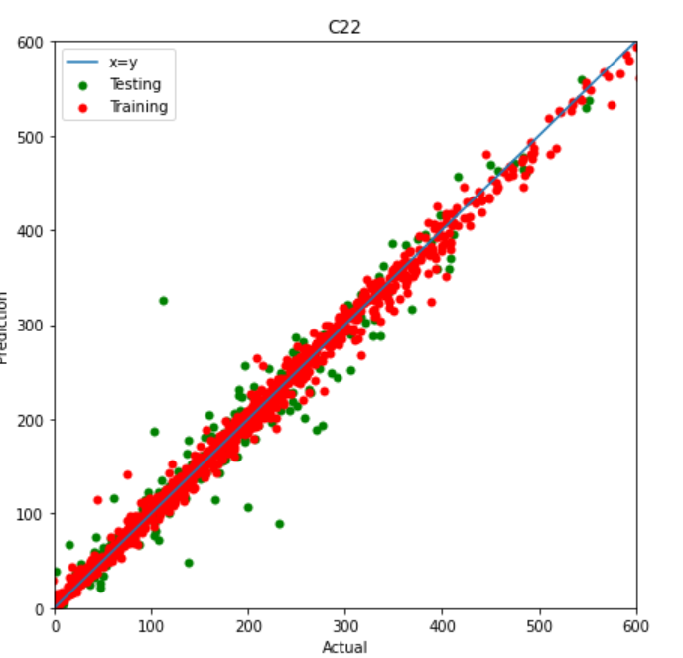
Test Results & Conclusions

Slide 12
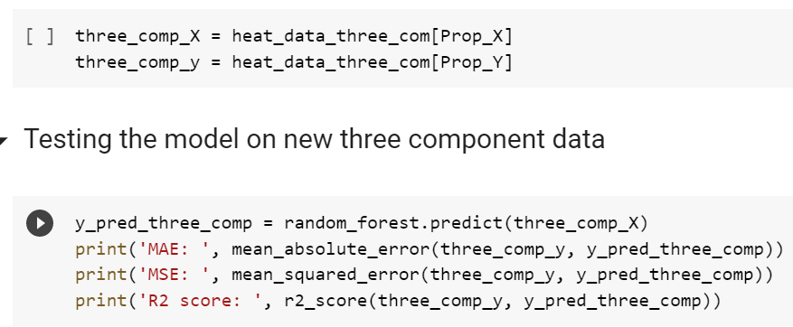
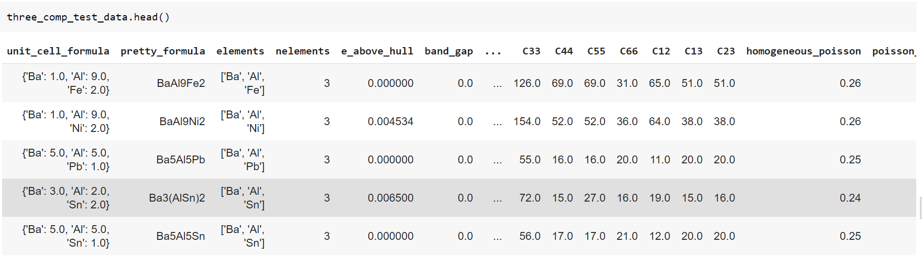
Ternary Alloys
The same model trained on Binary alloys was used to predict elastic constants for 1260 ternary alloys of 44 metals from Materials Project Database

Slide 13
Test Results & Conclusions
MAE: 14.11
MSE: 783.02
R2 score: 0.795
Low MAE and High R2 values indicates that good accuracy of the model.
The model is predicting with less accuracy compared to binary alloys as expected.
This shows the model is generalizing well even for ternary alloys.
MSE values are higher due to the presence of outliers or large variance in the data.
Model is not predicting well for higher values of Elastic constants since we have less data points in this range.

Slide 14
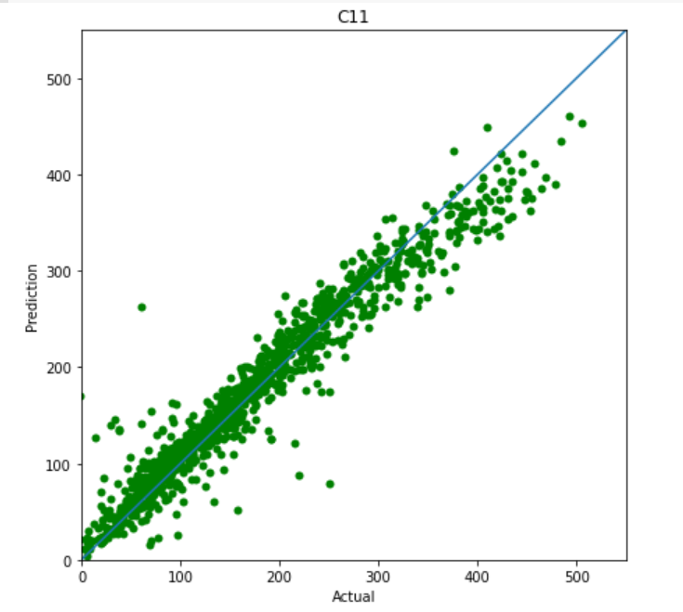
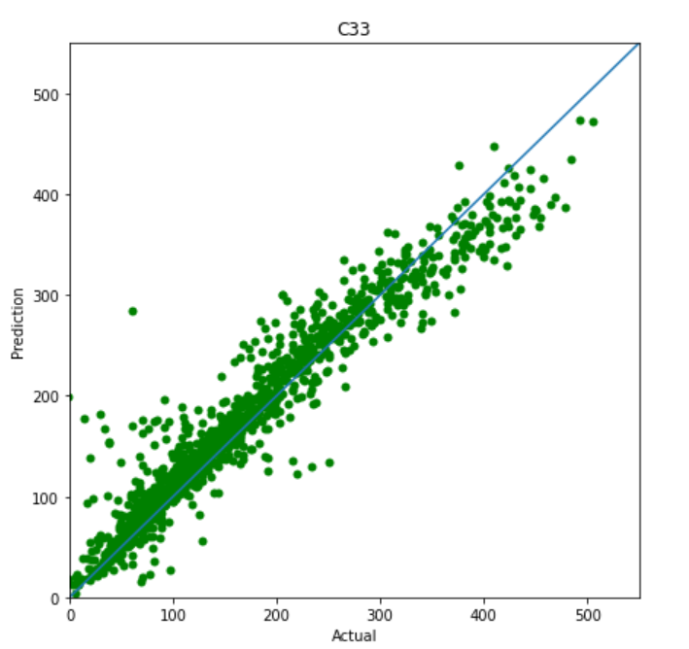
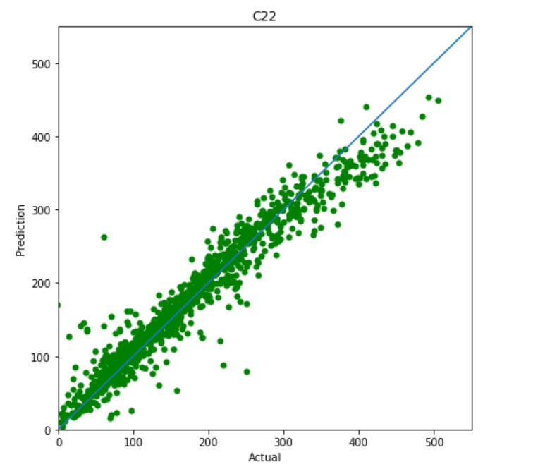
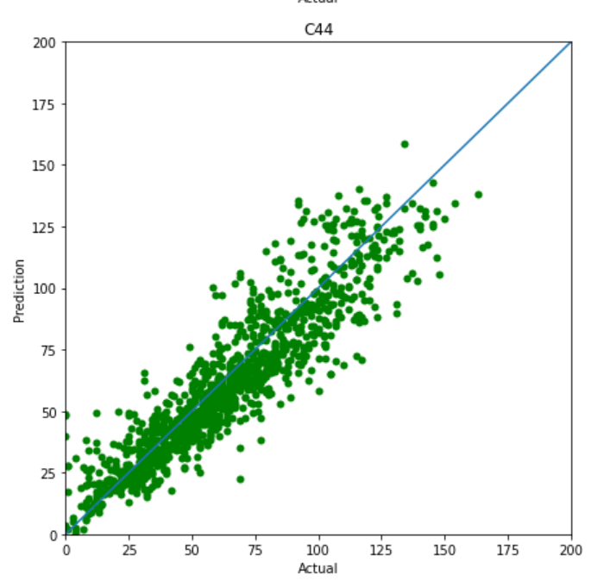
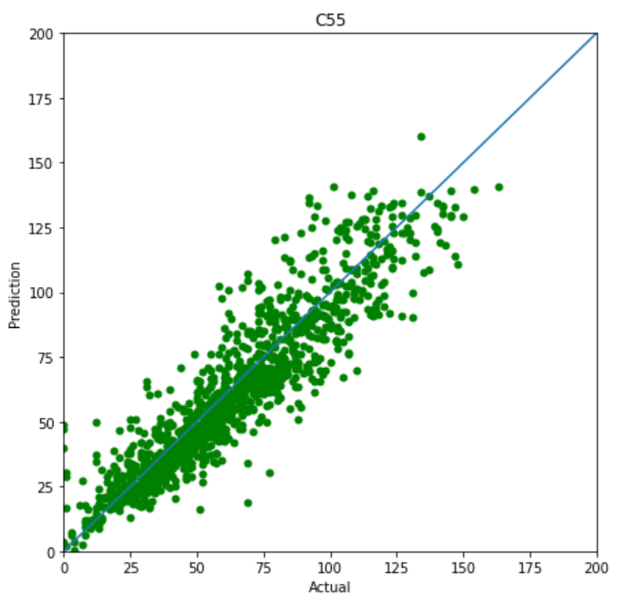
Test Results & Conclusions

Slide 15
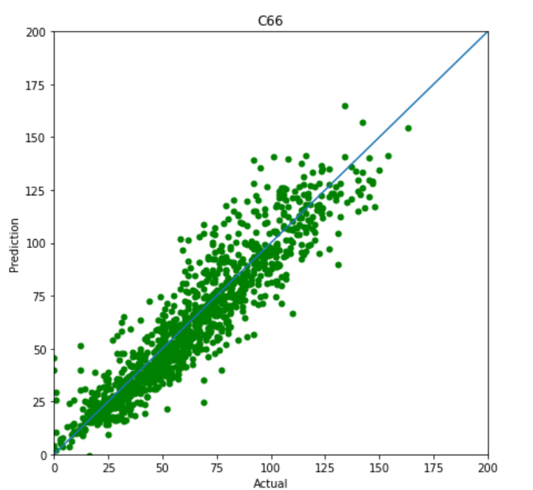
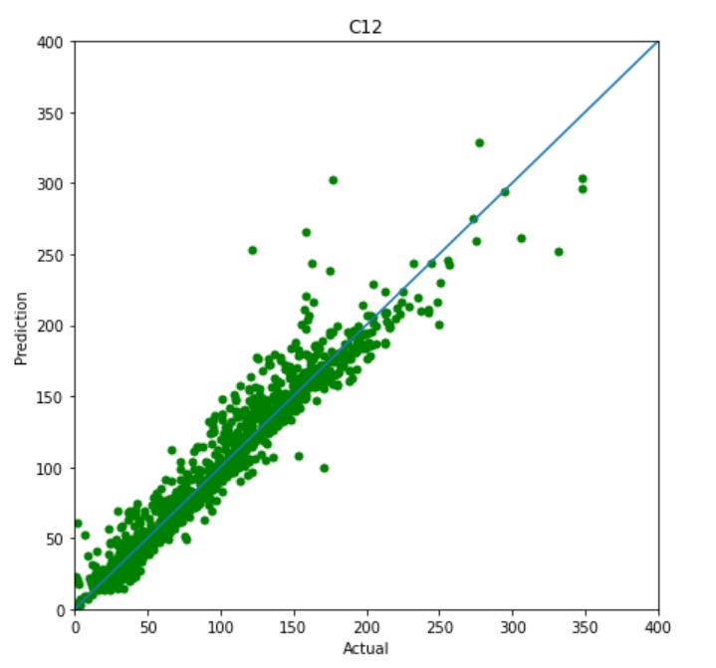
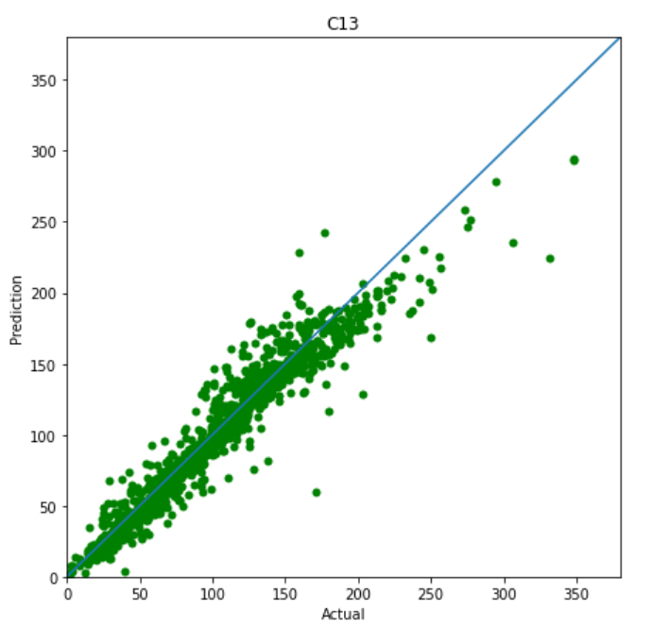

Test Results & Conclusions

Slide 16
Challenges Faced
Data collection, MPRester API, Pymatgen
Data Preprocessing
Feature Selection
Representing the predictions graphically

Slide 17
Thank You

